Slide 1



s GPTforALL s Aditya Thurvas Senthil Kumar Heena Chandak Shreya Ajay Kale
Reducing ML Development Cycle Time
Green/Sustainable AI
AI Safety & Trust

Slide 2
Problem Statement
Training large language models (LLMs) like GPT-3 requires expensive compute and high energy usage, limiting access
ChatGPT demonstrated the capabilities of LLMs, now companies want tailored models for niche use cases
Fine-tuning standard models is complex, requiring GPU clusters or third parties, raising privacy concerns
Lowers barriers to creating specialized LLMs for small companies and individuals
Empowers users to build AI that works for them, not just big tech companies

Slide 3
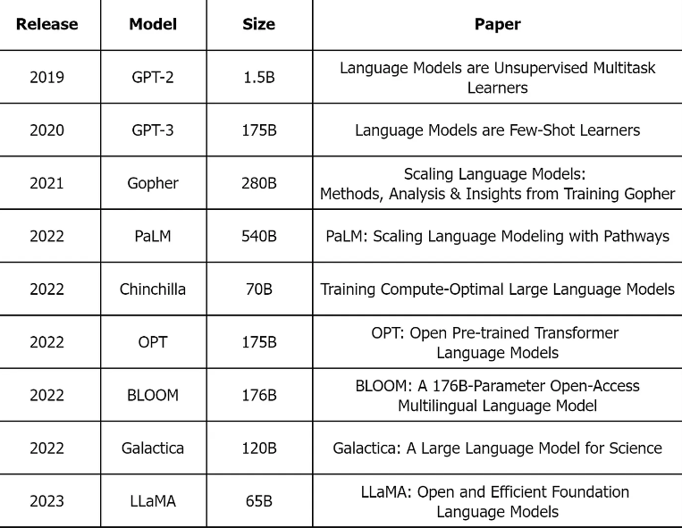
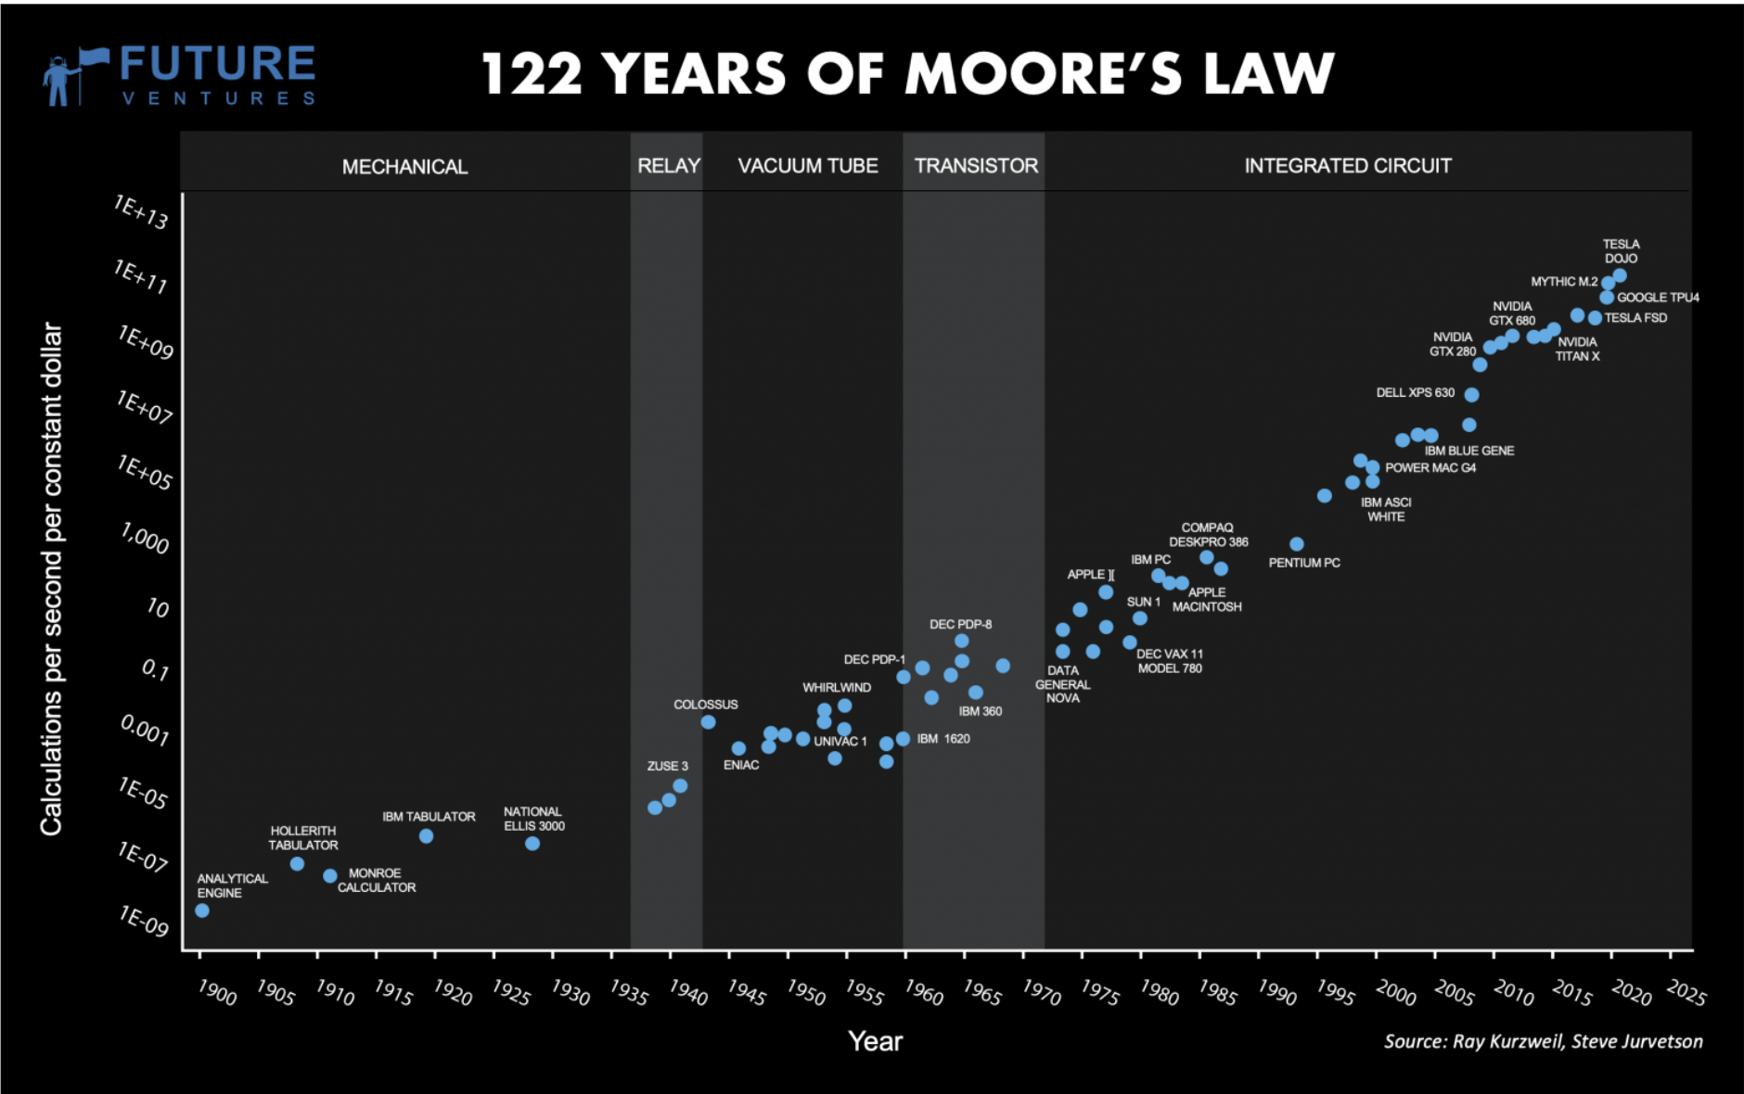
NLP’s Moore’s Law: Every year model size increases by 10x
Notes:
Chart on right: Moore’s Law charts the continuing increase in computing power. Each dot represents an attempt to build the best computer of the day.
With AI already being integrated into search engines like Bing and Bard, more computing power is needed to train and run models. Experts say this could increase the computing power needed—as well as the energy used—by up to five times per search. Moreover, AI models need to be continually retrained to keep up to date with current information

Slide 4
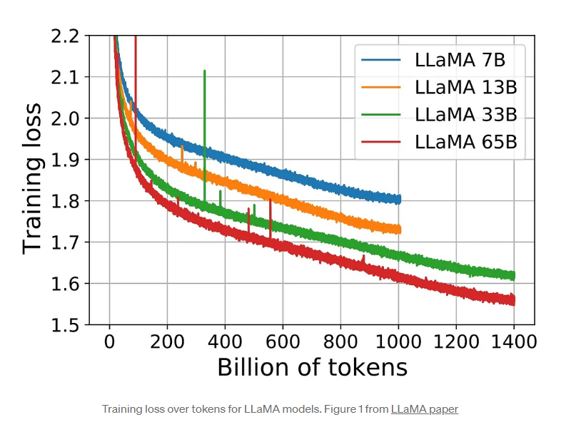
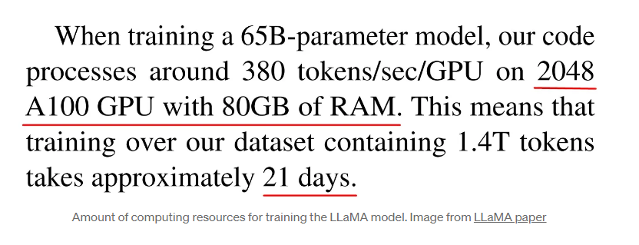
Training Costs
LLMs require massive data, compute and expertise for Training:
Data: Trillions of text tokens, terabytes of training data
Compute: Thousands of cutting-edge GPUs, millions in cloud costs
Expertise: Specialized skills across CS, salaries in $100Ks

Slide 5
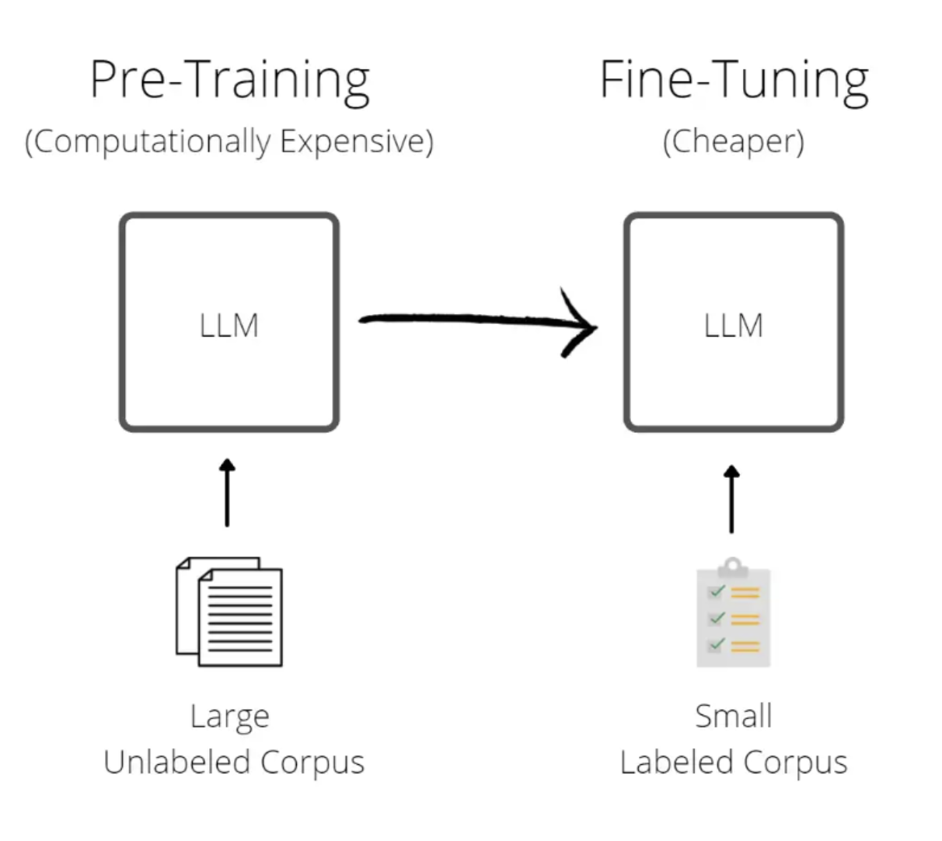
Motivations for Finetuning
Finetuning makes LLMs more usable and personalized
Pretraining teaches general language skills
Billions of parameters limit niche mastery, small data
Finetuning on target data improves customization
Enables classifying small datasets, grasping terminology
Balancing capabilities and responsible AI deployment

Slide 6
Solution
GPTforALL
On low resource device training with an intuitive UI, democratizing access to powerful AI
Users can train customized models on their own data on their own system using autoML, preserving privacy
No need for expensive infrastructure or relying on external parties with sensitive data
Easily build niche models with 10-100x efficiency gains over standard fine-tuning approaches
Deploy locally trained models securely within existing infrastructure and systems

Slide 7
LLaMA-7B (using LoRA & PEFT)
Open source 7 billion parameter model
Supports text classification, QA, generation, translation
Green/Sustainable AI
 | LLaMA-7B | LLaMA-7B + LoRA + PEFT
# Parameters | 7B | 7B
Quantization | - | 4x smaller
Tuning Method | Full finetuning | LoRA + PEFT
Tunable Parameters | 7B | <1% of 7B
Hardware Needs | Thousands of GPUs | Consumer devices
Inference Speed | Baseline | No change
Customization | Task-specific models | Small add-on weights
Catastrophic Forgetting | High risk | Low risk
AI Safety & Trust
Reducing ML Development Cycle Time

Slide 8
Example Use Case:
Medical Text for Text Classification
Purpose:
Identification of medical conditions from abstracts
Data: https://www.kaggle.com/datasets/chaitanyakck/medical-text
Used 1250 labeled abstracts for training
5 disease classes: Digestive, Cardiovascular, Neoplasms, Nervous System, General Pathological
Enviornment: Google Collab (Nvidia - T4 GPUs)
Total Training time: ~24 minutes (1250 datapoints) for 1 epoch
Usage:
Train models on labeled abstracts
Evaluate performance on unlabeled data

Slide 9
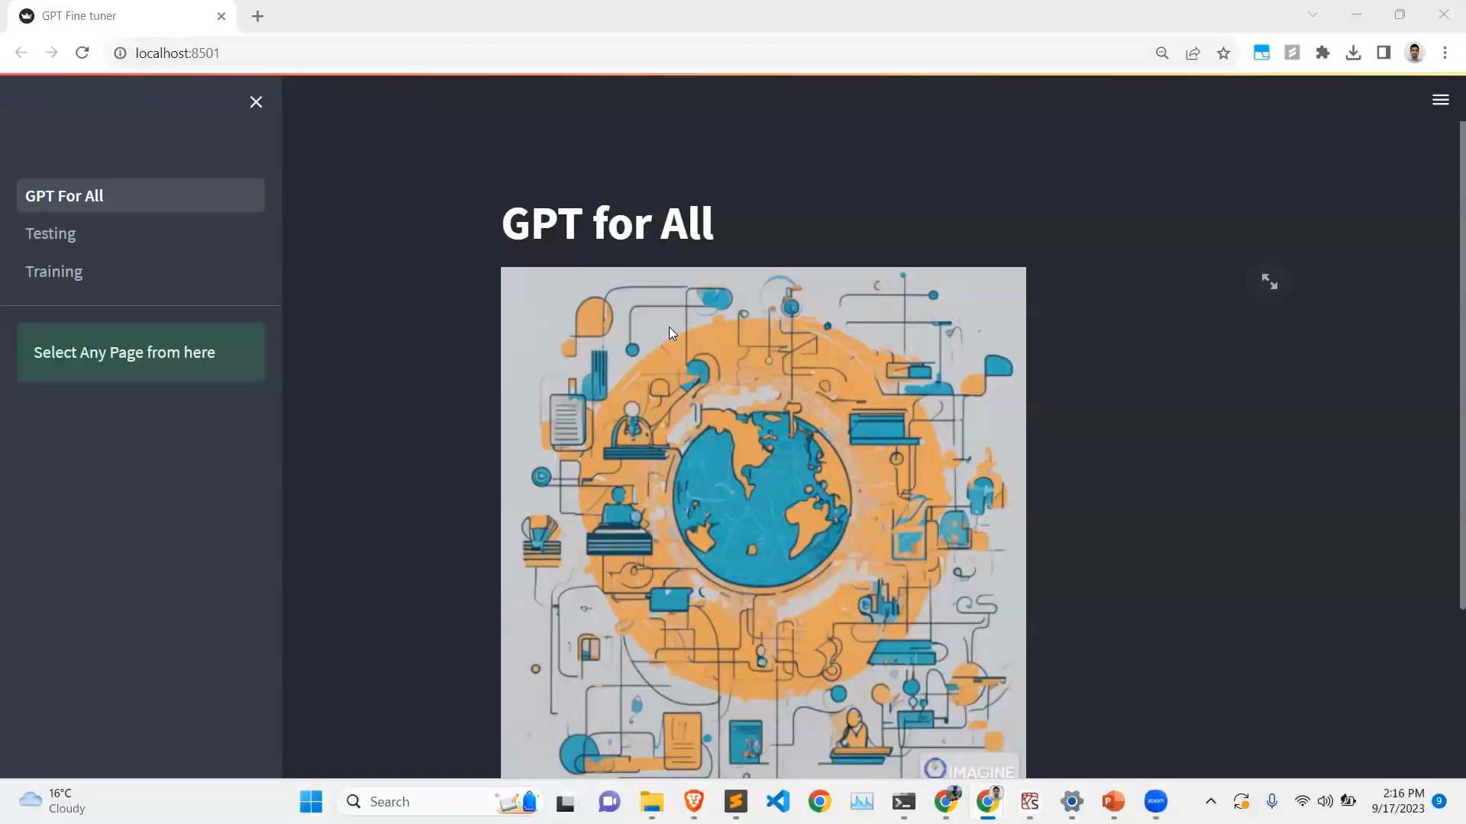
UI APP:

Slide 10
References
LORA: LOW-RANK ADAPTATION OF LARGE LANGUAGE MODELS https://arxiv.org/pdf/2106.09685.pdf
LLaMA: Open and Efficient Foundation Language Models https://research.facebook.com/publications/llama-open-and-efficient-foundation-language-models/
PEFT: Parameter-Efficient Fine-Tuning of Billion-Scale Models on Low-Resource Hardware
https://huggingface.co/blog/peft

